Slide 1
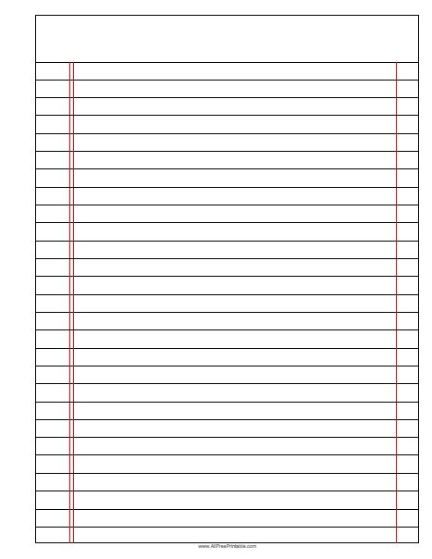






Prior Knowledge Review
Read Now
Sunday 18 January 2026
Prior Knowledge Review
Task:
Complete the Read Now by:
Stick in the sheet.
Using a highlighter as you read to identify key terms.
Answer the first four recall questions under the sheet in your book.
Answer the stretch question
Prior Knowledge Review
Prior Knowledge Review
Aim High | Work Together | Be Kind | Lead the Way

Slide 2
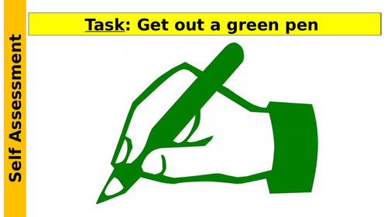
Read Now
Aim High | Work Together | Be Kind | Lead the Way
Aim High | Work Together | Be Kind | Lead the Way

Slide 3
Read Now
MARK SCHEME
1. Interdependence is when organisms depend on each other.
2. Plants provide food and oxygen for animals.
3. Decomposers break down dead things.
4. Bees help plants by spreading seeds.
5. Organisms rely on each other for survival and balance.
Aim High | Work Together | Be Kind | Lead the Way
Aim High | Work Together | Be Kind | Lead the Way

Slide 4
Daily Review
Follow your teachers instructions:
“When I say go show me a MWB and a MWB Pen”
You will have 10 seconds for each question.
Hold your MWB in the Ready position
“Show me”
You need to score 70% to pass
Subtitle ‘test score’ ?/10
Aim High | Work Together | Be Kind | Lead the Way
Notes:
Teachers remember to input the quiz score

Slide 5
Objectives
Following this lesson, students will be able to:
• State the definitions of producer, consumer, predator and prey
• Describe the transfer of energy through a food chain
• Explain the importance of plants in food chains
Lesson 1
Lesson 2
Lesson 3
Lesson 4
Lesson 5
Lesson 6
Lesson 8
Lesson 9
Lesson 10
Lesson 7
Aim High | Work Together | Be Kind | Lead the Way
Notes:
11.2 5.19

Slide 6
Exposition
Aim High | Work Together | Be Kind | Lead the Way
Notes:
11.31 1.42
11.2 4.35

Slide 7
Exposition
Aim High | Work Together | Be Kind | Lead the Way
Notes:
11.31 1.42
11.2 4.35

Slide 8
Exposition
Aim High | Work Together | Be Kind | Lead the Way
Notes:
11.2 1.43
11.2 1.7

Slide 9
Deliberate Practice
Big Question:
Aim High | Work Together | Be Kind | Lead the Way

Slide 10

Deliberate Practice
Aim High | Work Together | Be Kind | Lead the Way

Slide 11
Exit Ticket
1. Which best describes what the arrows on a food chain or web represent?
A. Which animals are being eaten
B. The direction of energy transfer
C. Producers, primary consumers and secondary consumers
2. A primary consumer is …
A. a carnivore that only eats plants
B. a herbivore that eats other animals
C. a herbivore that eats plants or algae
3. What piece of equipment would be used to count the number of organisms present in a certain place?
A. A quadrat
B. A transect
C. A sample
Aim High | Work Together | Be Kind | Lead the Way

